Slide 1
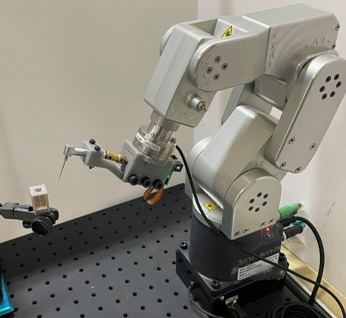
Robot-Assisted Endodontic Treatment Based on Force-Guided Alignment and File Feedrate Control
DentiBot
Presenter: Yi-Chan Li
Advisor: Prof. Cheng-Wei Chen
Date: 2021/06/22

Slide 2
Outline
Motivation and Problem Definition
Previous Work
Proposed Method
Experimental Results
Discussion and Conclusion

Slide 3
Outline
Motivation and Problem Definition
Previous Work
Proposed Method
Experimental Results
Discussion and Conclusion

Slide 4
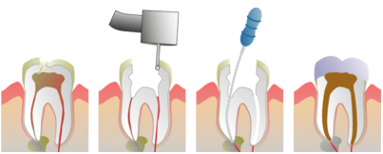
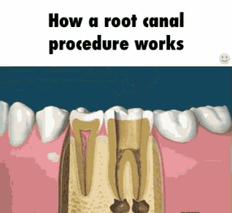



Endodontic Treatment
Time-consuming
Repetitive movements
Expertise and experiences
Opening
Cleaning
Filling
15,178 Dentists
238 Endodontists
High cost

Slide 5
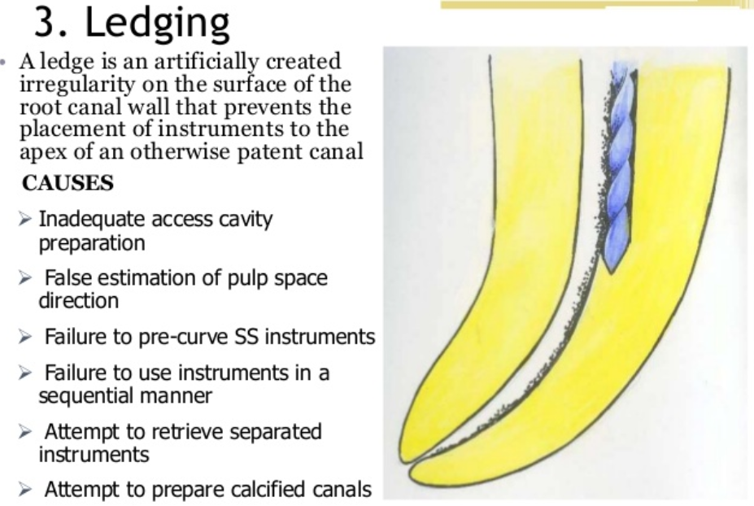
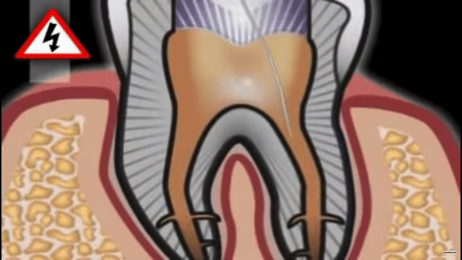
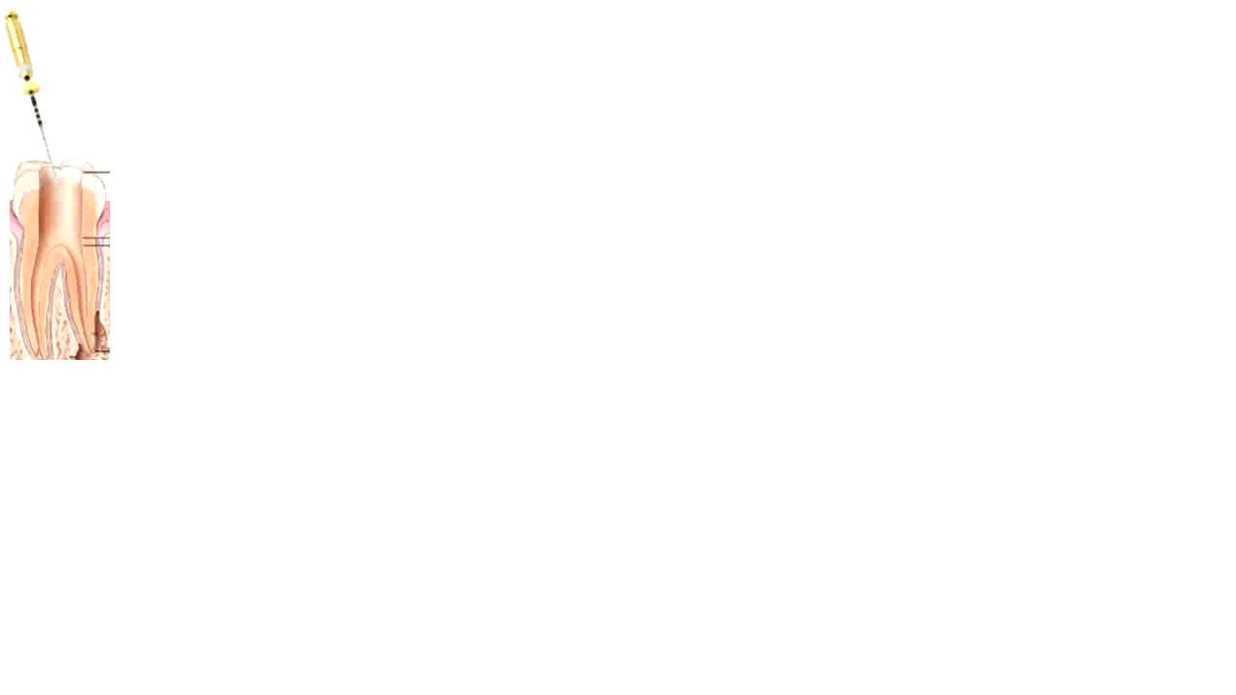
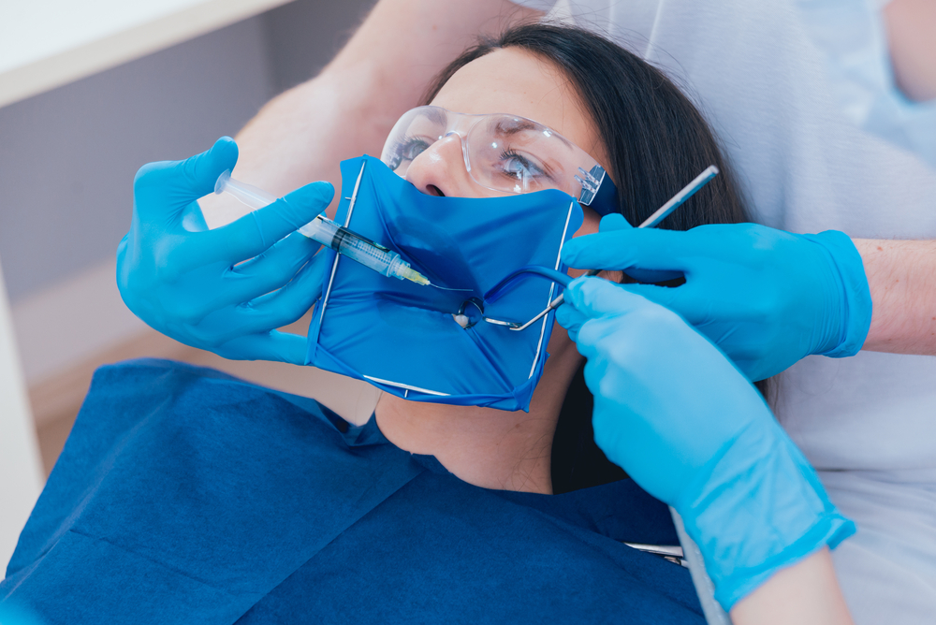
Challenges
Small
Instrument fracture
No real-time image
Root canal direction?
0.28 mm
Figure source:
Notes:
https://riverparkdentalct.com/endodontics/

Slide 6
Problem Statement
1. How to assist dentists in performing “Cleaning” procedure?
2. How to align an unknown root canal direction?
3. How to protect the endodontic file from fracturing?
Notes:
\item \item \item

Slide 7
Outline
Motivation and Problem Definition
Previous Work
Proposed Method
Experimental Results
Discussion and Conclusion

Slide 8
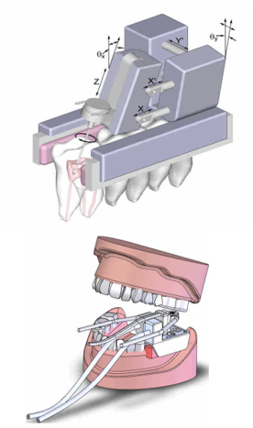
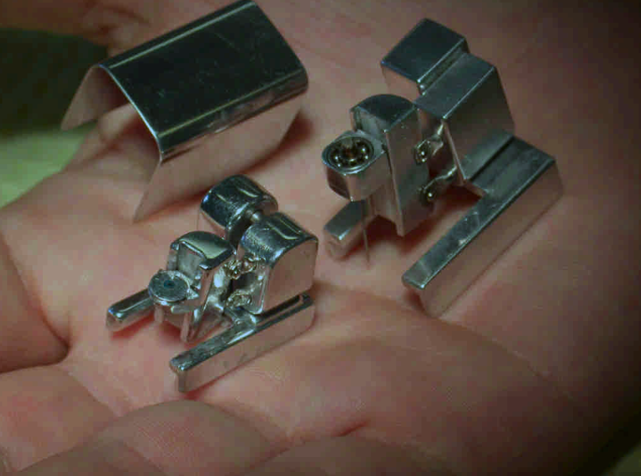
Endodontic Robot
Dong, J., Hong, S., & Hesselgren, G. (2006). WIP: a study on the development of endodontic micro robot. In Proceedings of the 2006 IJME-INTERTECH Conference.

Slide 9
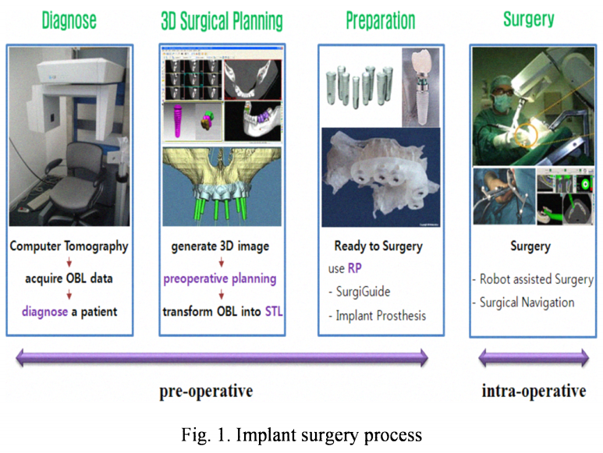
Endodontic Robot

Slide 10
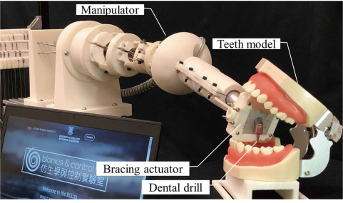
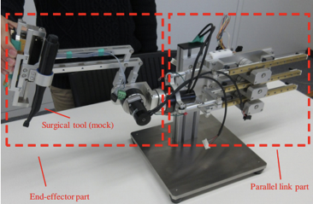
Other Dental Robots

Slide 11
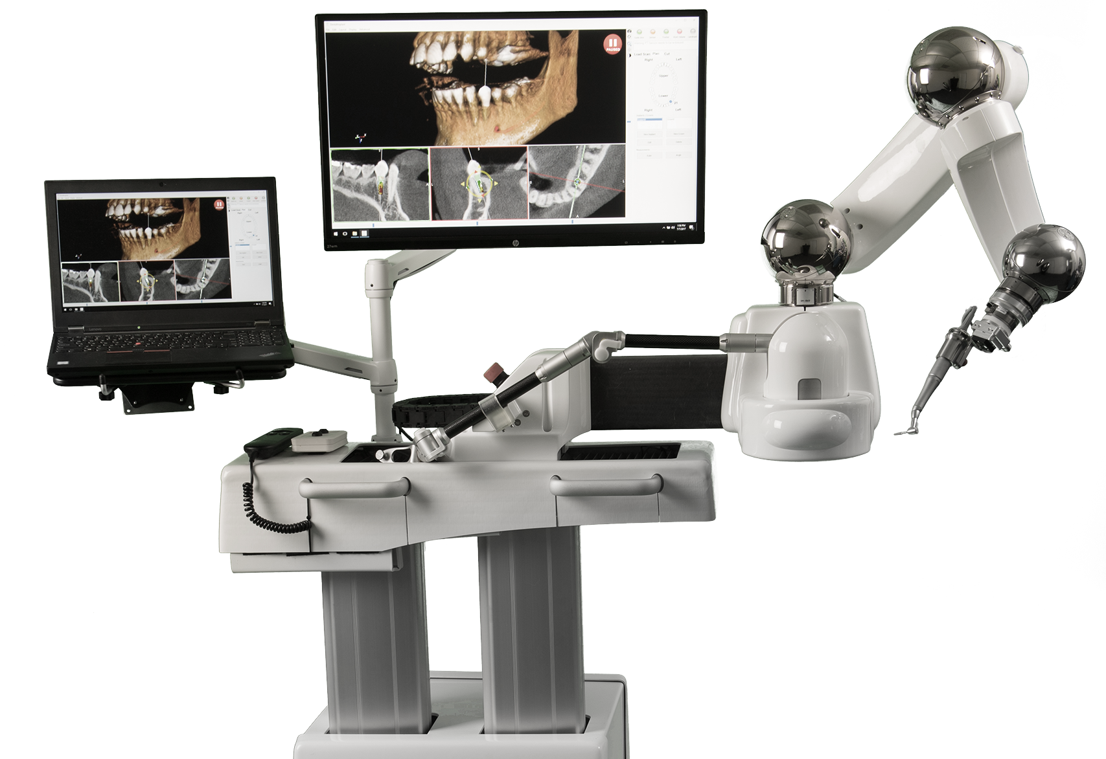
Commercial Dental Robot
Yomi Robotic System (Neocis Inc.)
surgical technology that assists dental implant surgery using 3D image of the patient.

Slide 12
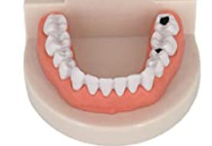
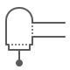
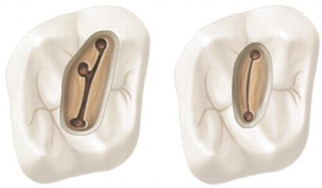
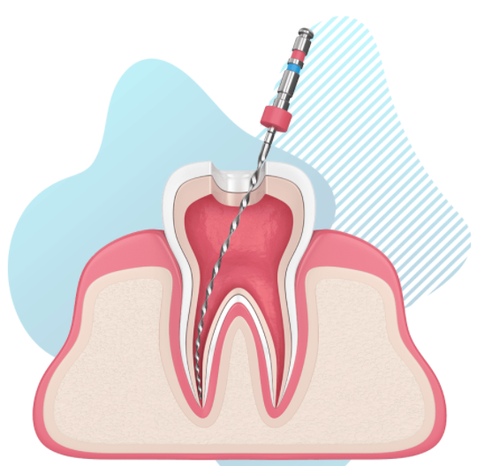
Prospect of DentiBot
Move to the infected teeth
Root canal searching
Repetitive drilling
Apex detection
Figure source:
https://www.rabinefamilydentistry.com/root-canals/
Notes:
\item \item \item

Slide 13
Problem Statement
1. How to assist dentists in performing “Cleaning” procedure?
2. How to align an unknown root canal direction?
3. How to protect the endodontic file from fracturing?
Notes:
\item \item \item

Slide 14
Outline
Motivation and Problem Definition
Previous Work
Proposed Method
Experimental Results
Discussion and Conclusion

Slide 15



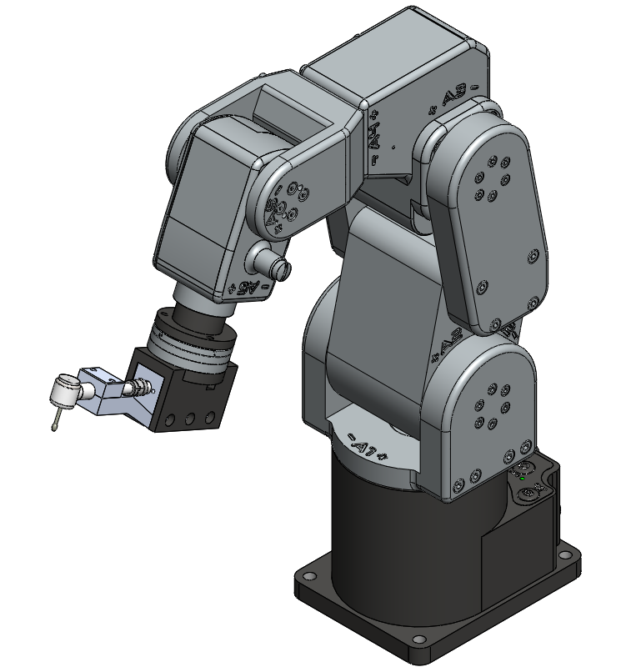
DentiBot
Modified
Handpiece
F/T Sensor
Robot Arm

Slide 16

System Integration
What problems should we solve?
Kinematics (Forward, Inverse, and Jacobian)
EtherCAT
Robot Arm
Gravity compensation
Reference frame changing
RTOS
F/T Sensor
Coordinate transformation
Translation Analysis - Tool Center Point
Rotation Analysis
Modified Handpiece

Slide 17
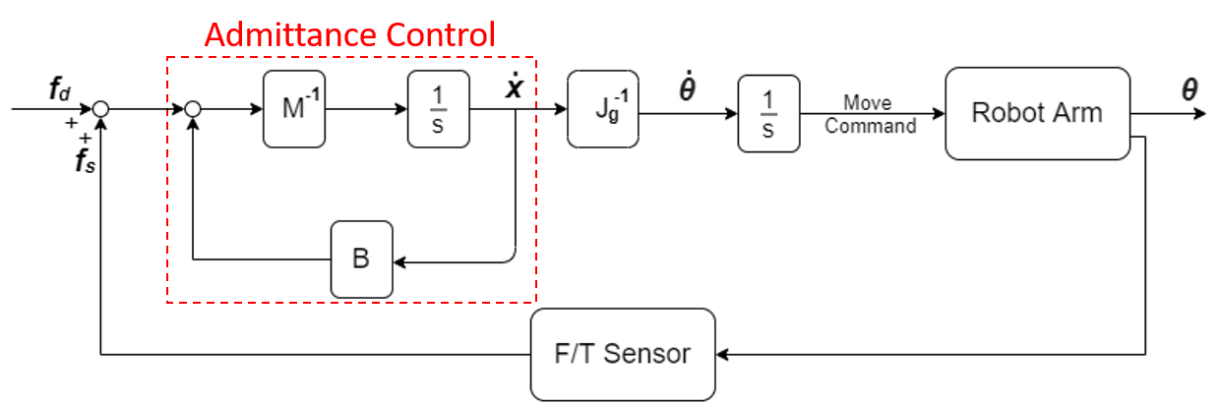
Control Scheme
Dragging Mode vs. Self-Alignment Mode
Notes:
Dragging mode

Slide 18
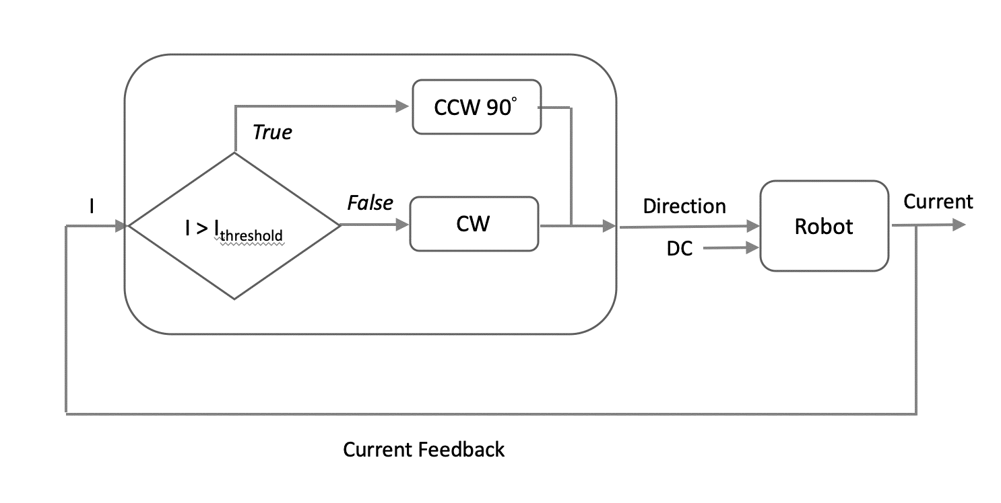
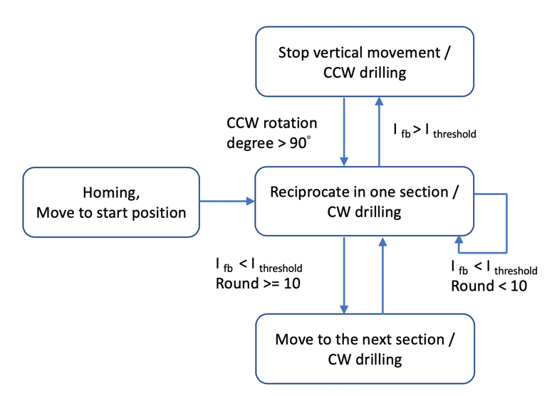
Instrument Protection
Two main causes of instrument fracture
1. Cyclic fatigue 70%
2. Torsional stress 30%
Solution:
Torque Sensing from Current Feedback
Driller

Slide 19
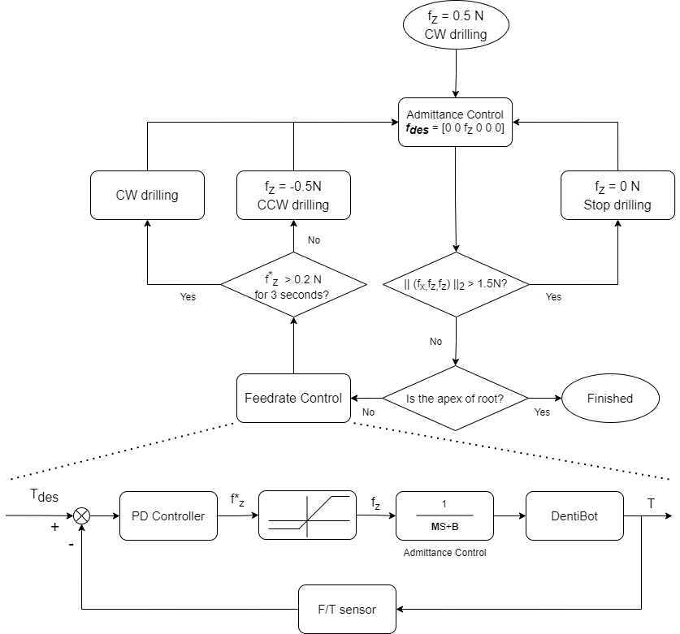
Flow Chart

Slide 20
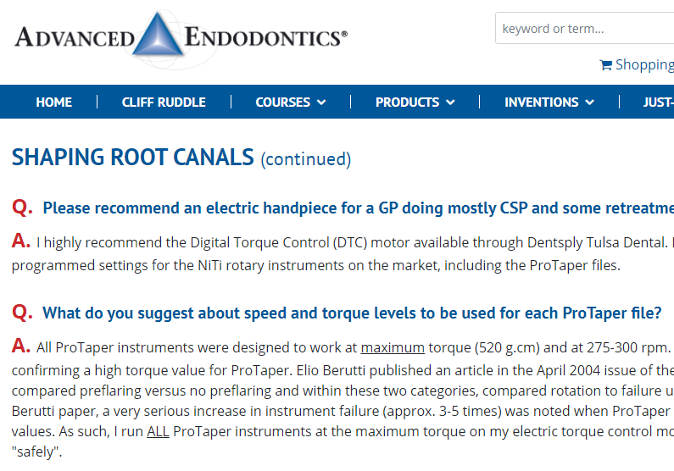
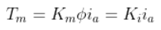
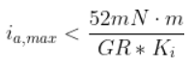
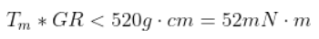
Instrument Protection
Screen shot from https://www.endoruddle.com/

Slide 21
Outline
Motivation and Problem Definition
Previous Work
Proposed Method
Experimental Results
Discussion and Conclusion

Slide 22
Video
Notes:
\item \item \item

Slide 23
Outline
Motivation and Problem Definition
Previous Work
Proposed Method
Experimental Results
Discussion and Conclusion

Slide 24
Main Contribution
Integrate a 6-DoF robotic manipulator with 6-DoF F/T sensor for performing endodontic treatment.
Develop a framework for robot alignment regarding the position and orientation of root canal.
Protect the endodontic file from fracturing by controlling file rotation speed.

Slide 25
Future Work
Discuss the feature of endodontic file more deeply.
Patient tracking
Root canal searching
Apex detection

Slide 26
Main References

Slide 27
Thanks for your attention
Q & A

Slide 28
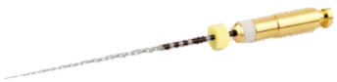
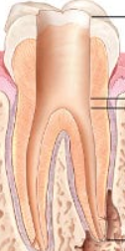
Preparation

